Slide 1
INS SENSOR CALIBRATION USING ML
Raghunandan
DEAIS
M.Swapna, Sc.E
Dr. Yogeshwar Singh

Slide 2
PROBLEM STATEMENT
Development of a machine learning model to estimate the complete set of INS sensor calibration parameters, including biases, scale factors, and misalignment terms, while accounting for temperature-dependent variations, for accurate modelling and correction of sensor errors, with the objective of reducing calibration time.

Slide 3
LITERATURE SURVEY
R. Pesti, P. Sarcevic, and A. Odry, “Artificial neural network-based MEMS accelerometer array calibration,” International Journal of Intelligent Robotics and Applications, 2025, doi: 10.1007/s41315-025-00438-2.
N. B. Vavilova, I. A. Vasineva, A. A. Golovan, A. V. Kozlov, I. A. Papusha, and N. A. Parusnikov, "The Calibration Problem in Inertial Navigation," Journal of Mathematical Sciences, vol. 253, no. 6, pp. 839–860, Mar. 2021. doi: 10.1007/s10958-021-05267-9.

Slide 4
GENERAL APPROACH
Collect synchronized raw accelerometer readings (X, Y, Z) and temperature data.
Preprocess and align datasets to remove noise and outliers.
Define target calibration parameters (biases, scale factors, misalignment errors) for all axes.
Train a supervised neural network mapping 4 inputs → 12 error parameters. For example, the four inputs can be accel_x, accel_y, accel_z, temp and the 12 outputs can be all error parameters for all three axes
Apply predicted errors to generate calibrated accelerometer outputs.
Validate performance against reference measurements.

Slide 5
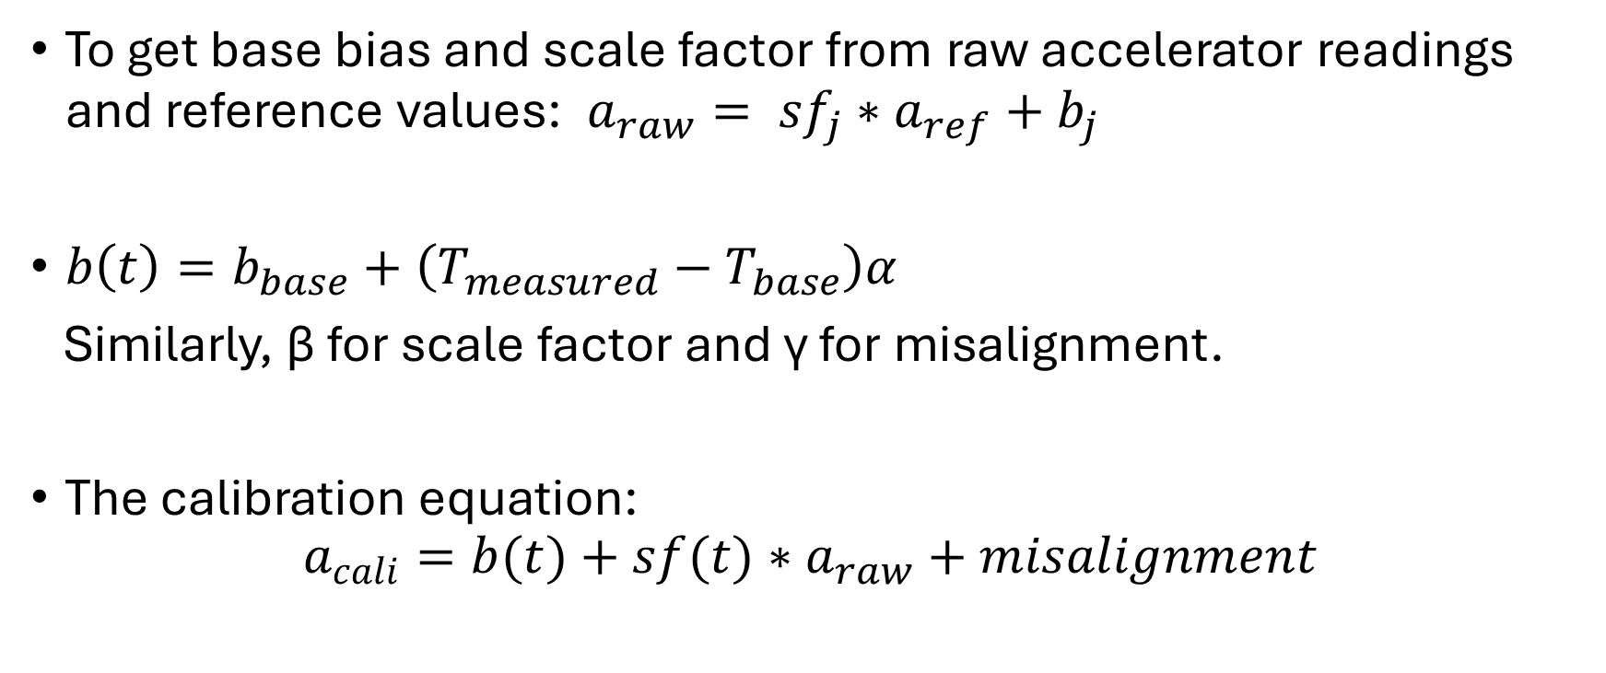
EQUATIONS
To get base bias and scale factor from raw accelerator readings and reference values:$a_{raw}= {sf}_{j}∗a_{ref}+b_{j}$
$b\left(t\right)=b_{base}+\left(T_{measured}−T_{base}\right)α$
Similarly, $\text{β}$ for scale factor and $\text{γ} \text{for} \text{misalignment}$.
The calibration equation:
$$a_{cali}=b(t)+sf(t)∗a_{raw}+misalignment$$

Slide 6
PROGRESS
Checked all datasets
Full Understanding of Feature Set
Studied the process which was used to get the calibrated acceleration values for each x, y, z axis and the equations and steps involved in it to produce the necessary error parameters like bias, scale factor and misalignment for finding the calibrated value
Identifying and Studying Applicable Neural Network Models

